Slide 1
Orleans Roadmap
Not a 5 year plan
Virtual Meetup #8, January 21st 2016

Slide 2
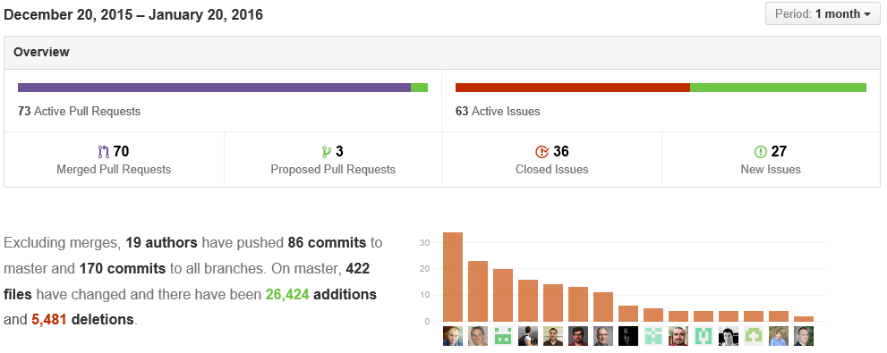
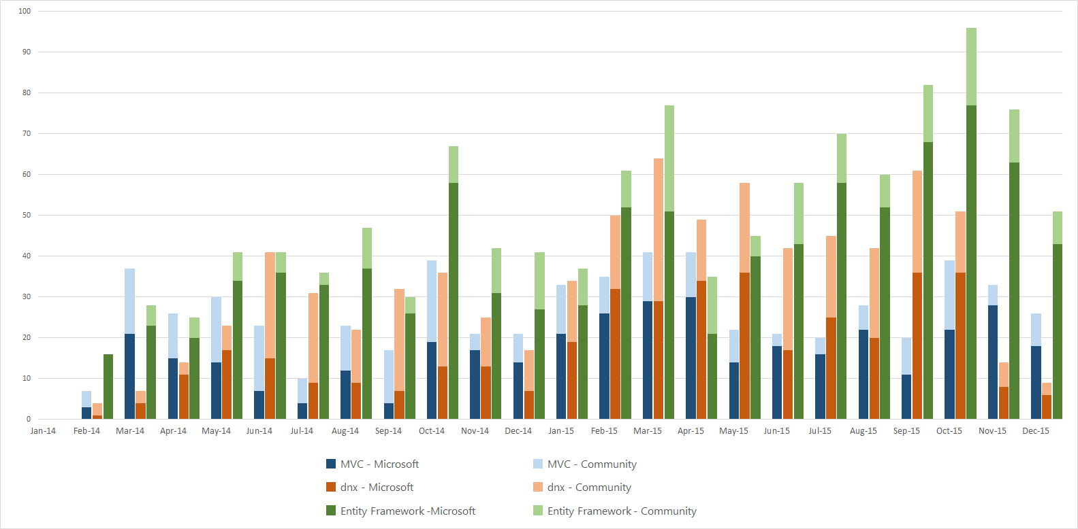
How we are doing
A typical month:
7o PRs merged
56% Community / 44% MS
For comparison:
Merged PRs in MVC/dnx/EF

Slide 3
Bigger bolder changes by community
Revamped support for SQL and MySQL
Pluggable membership storage
Codegen “heart transplant”, run time codegen
Pluggable telemetry consumers
Pluggable serializers
ASP.NET vNext DI
Elimination of GrainState
THANK YOU!

Slide 4
Orleans Tenets
Developer productivity
Make building distributed systems qualitatively simpler
Empower developers to focus on more interesting problems
Less code, simpler code, proven patterns
Time to market
Scalability by default
Scale by orders of magnitude without major rewrites
Avoid bottlenecks in runtime
Prevent bottlenecks in app code
Encapsulate proven patterns
Openness, flexibility, fast evolution

Slide 5
Uber-goals
Technology of choice for building scalable systems
Developer productivity across diverse skill sets and problem domains
Future-proof development via built-in scalability and openness
Runs anywhere you need, the way you need
Open, flexible, composable with a wide range of technologies
Rich ecosystem of tools and extensions
Vibrant community to tap for help, hire or to hang out with
Change the way people think about distributed apps

Slide 6
How we get there
Constant refinement and fast fixes
Stream of new features
While avoiding cognitive overload, keeping the model simple
Themes – a set of features/changes towards a goal
Major refactoring
Learn from usage of a feature, reimplement, redesign
Integration with other technologies
Focus on our tenets, leverage others
Big bold bets

Slide 7
Immediate plans
1.2.0 release in 2-4 weeks, hopefully
EventHub stream adapter ported from 343i
Request interceptors (by @ReubenBond)
Everything else that’s in by then
Integration of geo-distribution code
Global single instance grains
Replicated/queued grains
Event Sourcing

Slide 8
High priority themes
CoreCLR compatibility
Codebase
Switching to xUnit
Deployment & cluster management
Better Azure PaaS experience
YAMS
Service Fabric
Containers
DI for application code and runtime
Persistence v2

Slide 9
Pri-2 work items (in no particular order)
Built-in web frontend for grains
Broadcast and grain groups
Documentation, samples, tutorials, project/solution templates
Non-static GrainClient to connect to multiple clusters
GrainReference vs. grain identity
Scalability of reminders
Monitoring and dashboards
Borrow back Orleankka’s features
Programmatic config, functional composition, environments, …
Versioning and in-place upgrade
Idiomatic support for F#
Test infrastructure for one-box and distributed tests
Simplified Streaming API
Reliable grain directory

Slide 10
Aspirations
ACID cross-grain transactions
Code analysis to flag most common mistakes
Integration with JavaScript and Node.js
Integration with Java/Orbit?
3rd party networking/messaging stack, TLS
3rd party ‘magic’ serializer
Open cross-platform messaging protocol
Intelligent rebalancing of grains
Push-button deployment: local, on premises, cloud

Slide 11
What did we miss?

